Slide 1
An Analysis of Corvid-19 Springboard Unit 20.3 Story Telling
Jiaqi Xu
Sep 2, 2020

Slide 2

Background of Coronavirus Disease 2019 (COVID‑19)
Caused by severe acute respiratory syndrome coronavirus 2
First identified in December 2019 in Wuhan, Hubei, China
As of 31 August 2020, more than 25.3 million cases have been reported all over the world and more than 848,000 deaths
Common symptoms include fever, cough, fatigue, shortness of breath or breathing difficulties, and loss of smell and taste
Source: https://www.newscientist.com/term/covid-19/

Slide 3
Dataset and Analysis
Dataset
2019 Novel Coronavirus COVID-19 (2019-nCoV) Data Repository by Johns Hopkins CSSE. https://github.com/CSSEGISandData/COVID-19
Analysis
Jupyter Notebook from Tarun Kumar. https://github.com/tarunk04/COVID-19-CaseStudy-and-Predictions
Data used up to Aug 24,2020

Slide 4
Questions
What is China case vs outside in first 60 days?
What is the testing data for each country?
What are confirmed, deaths, active and recovered for top 10 countries?
What is the spread trend in the world and continents
What is the spread trend in USA and prediction of next 7 days?

Slide 5
China Vs Outside China First 60 days

Slide 6
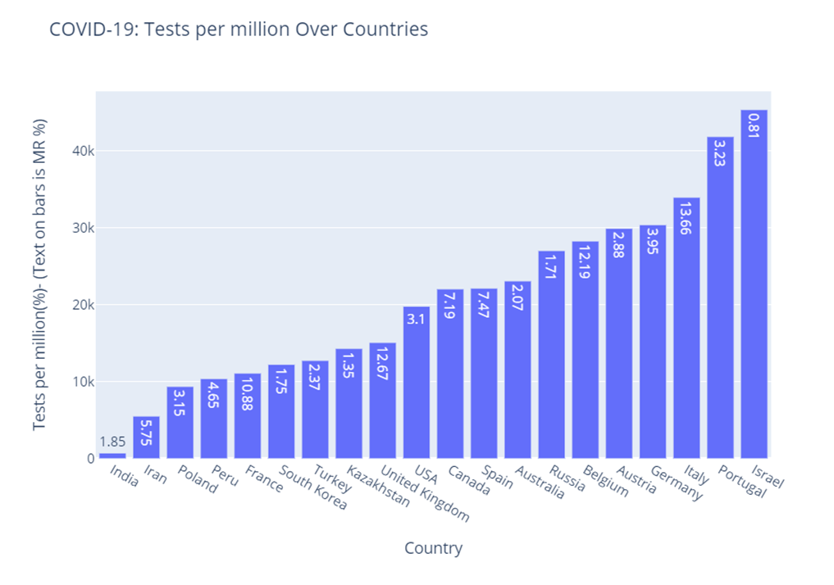
Graphical Analysis of Testing Data

Slide 7
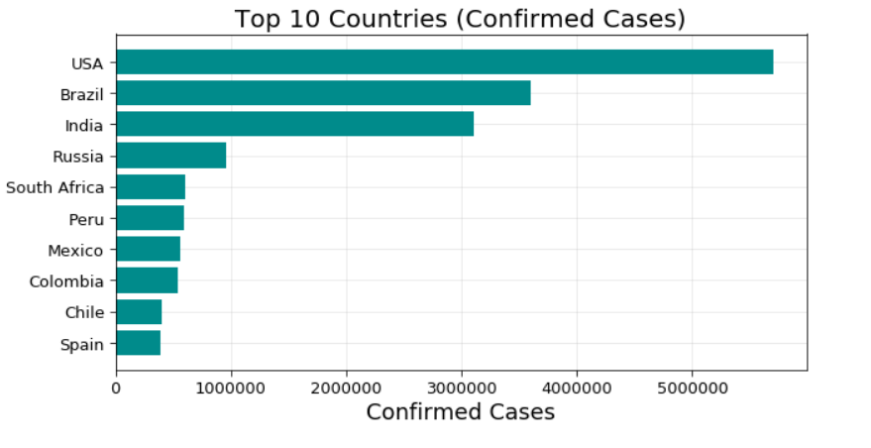
Confirmed, Deaths, Active and Recovered

Slide 8
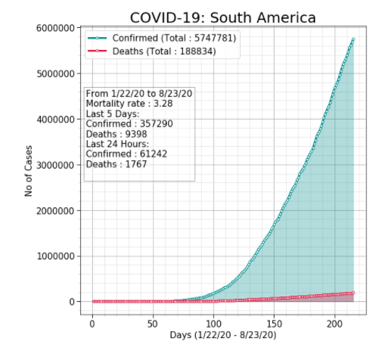
Spread Trends in the World and Continents

Slide 9
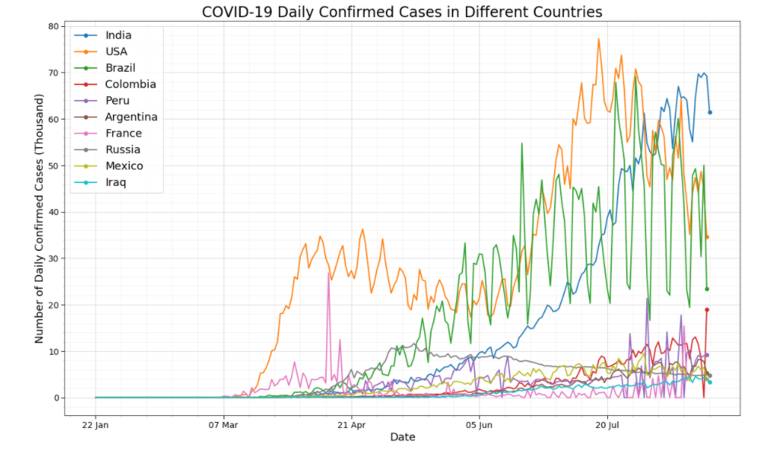
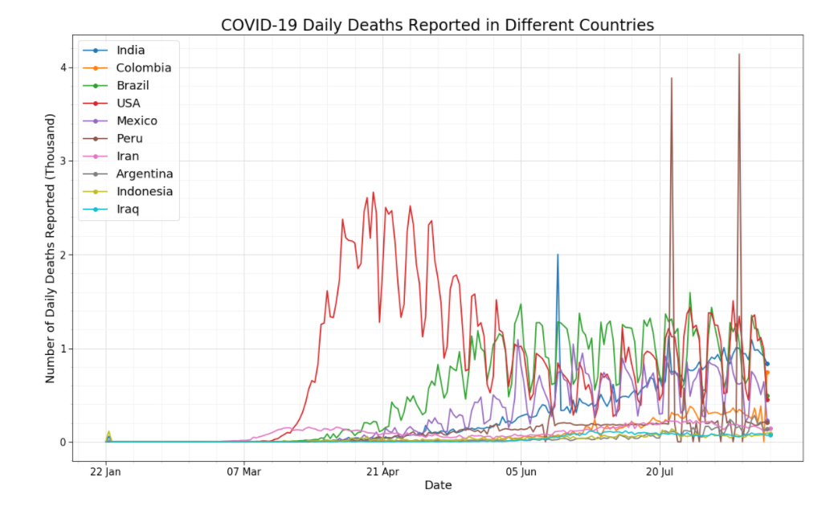
Daily Cases in Different Countries

Slide 10
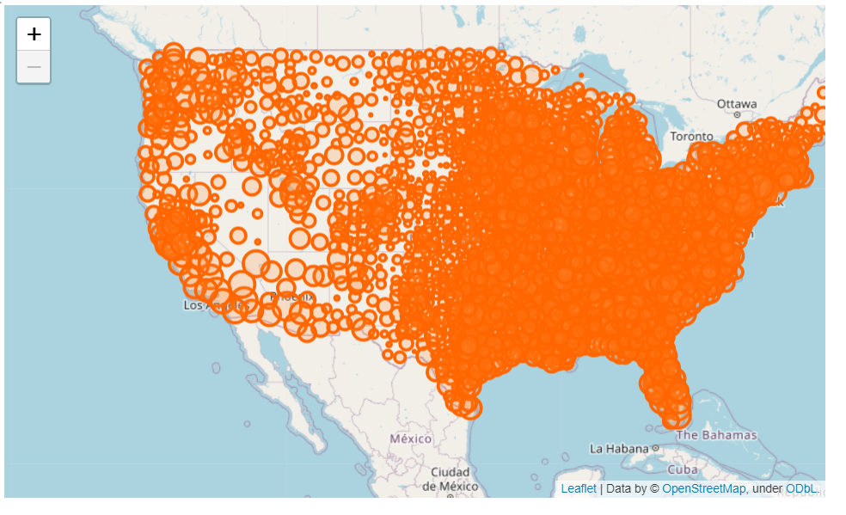
USA: Most Affected States

Slide 11
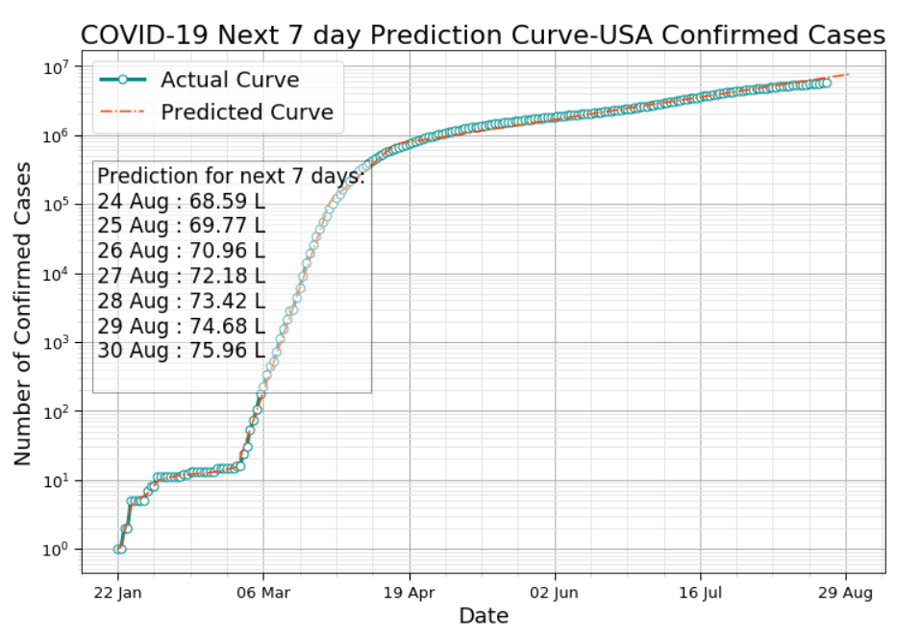
Prediction of Next 7 Days

Slide 12
Conclusion (up to Aug 24, 2020)
Most of the cases are concentered in China before mid of Feb
US has the maximum testing for population, Israel has the maximum testing per million
US, Brazil and India are most affected countries
Spread trend jumped after 50 days since 01/22/2020 and still increasing
Demographically, in US, west performs better than east
In US, next 7 days confirmed cases will be around 70K to 75K for each day

